Slide 1
Caldata and Barry Network
Advanced Optimization
Georgia Institute of Technology
12/9/2010

Slide 2
Caldata Network
Breaking the Symmetry
Bound up Constraint
Cut flow constraint

Slide 3
Caldata: Techniques
Applied breaking the symmetry constraint.
- We gave the priority to outer ring at each cycle.
Result :
Total Cost = 43.4525 millions
Number of ADMS to purchase: 39

Slide 4
Caldata: Techniques
II. Applied bound up constraints
- Decided to apply bound up constraints so we can set lower bound limit for number of ADMS for each hub in each cycle.
- lower bound limit was calculated by demand for each origin and destination.

Slide 5
Caldata: Techniques
II. Applied bound up constraints
Divided our problem into two:
hubs joint to other cycle: B,E,I,H,K,L
hubs not joint to other cycle:
A,C,D,F,G,J,M,N
- # ADM required at each hub >= sum of origin & destination demand at each hub / (2*bi-arc capacity)

Slide 6
Caldata: Techniques
III. Applied cut flow constraint
Divided graph into two
Upper region of hub E
Lower region of hub E

Slide 7
Caldata: Techniques
III. Applied cut flow constraint
Example)
# of ADM at hub E >= sum of flow from upper to lower region and lower to upper region / (2*bi-arc capacity)
- We applied the same method to:
hub F and hub G
hub F and hub L
hub H and hub L
hub J and hub K and hub L

Slide 8
Caldata: Techniques
IV. Constraint Generation
Binary -> LP
LP relaxation
the node ADM should be installed
Found all values > 1, assign them to 1
Repeat this LP relaxation until there are no value > 1
LP -> Binary

Slide 9
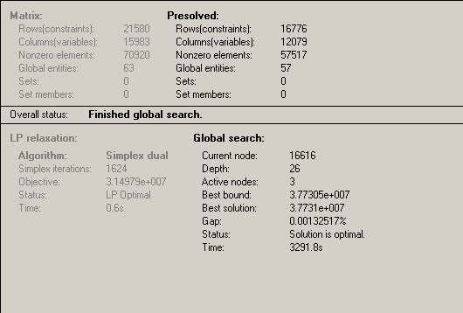
Caldata Result
Best bound : 3.773e+007
Best solution: 3.773e+007

Slide 10
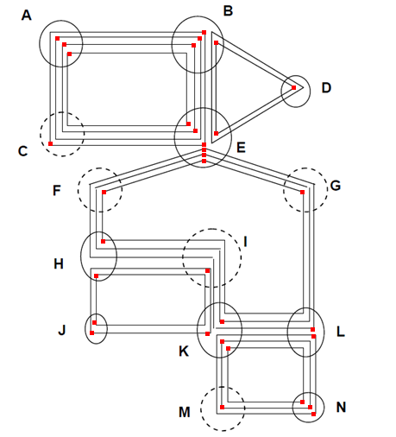
Caldata Network
Optimal Cost : $37.7 million
Total ADMS to purchase: 33
According to Xpress, we have reached an optimal solution because best solution reached best bound.
However, since we used heuristics about LP relaxation, we could have made some feasible solutions infeasible solution. If we used better constraint than heuristic, it could have reached better optimal solution.

Slide 11
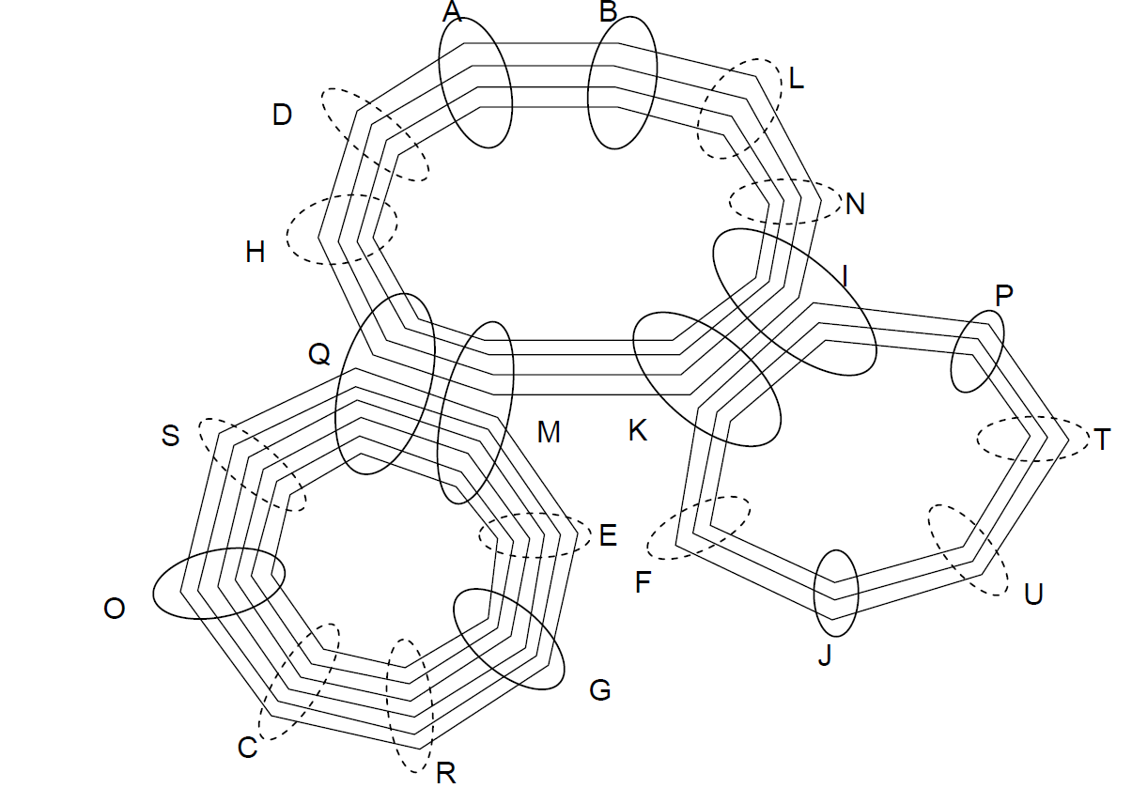
Barry Network

Slide 12
Barry: Techniques
I. Symmetry breaking
II. Cut flow constraint
- Q,M
- K,I
III. Constraint Generation
- run LP relaxation
- round up the highest fraction ( > 0.5)
- repeat the same steps.

Slide 13
Barry: Techniques
Picked hubs with higher demands
Draw diagram and determined which hubs require more ADMs compare to other hubs.
For hubs that require more ADMs we gave them higher priority.
We generated the constraint and ran it in Xpress.

Slide 14
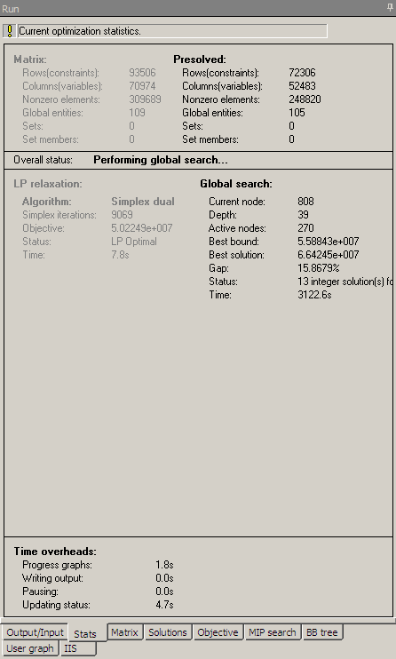
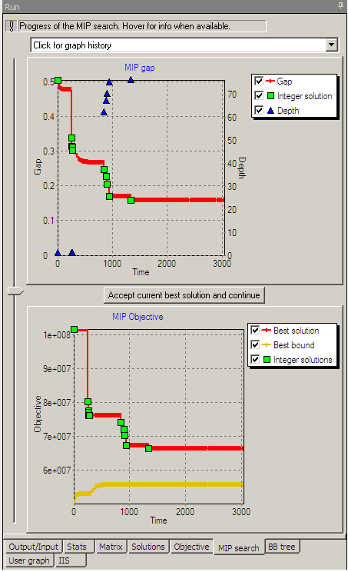
Barry: Result
Best solution: $66.42 million

